Slide 1

INSURANCE POLICY MANAGEMENT
Group 7

Slide 2
Team Members
Employee Id | Name
2504076 | Subhadip Samantha
2504045 | Summi Sinha
2503975 | Shubham Kumar
2506420 | shubham phulchand gupta
2507162 | Shubham Bapusaheb Bhavar
2503972 | Srinivas M R
2506335 | Shaik Kaleem Arshad
2503765 | Sk Rahaman
2504314 | Suraj Kumar Ramakrushna yergude
2505869 | Surendhra Kumar

Slide 3
INDEX
Introduction
Project Scope
Tools & Technologies
ER Diagram
Admin Module
User Module
Output
Conclusion

Slide 4
INTRODUCTION
Insurance Policy Management System is a web application which is used to tracking the details about the insurance policy, customer details and company details.
This project is useful for any kind of insurance company to manage the insurance details, to sanctioned the insurance for customer, process the insurance policy details and all kind of insurance process through online.
In this online process the user enter into the website it will show details about insurance and its types, also it will show the details about different duration schemes to the corresponding insurance type or insurance policy.
In this process contains the user registration form which is used to apply for insurance policy through online.
It also helps the customer to view their own insurance status information.
If the policy holder wants to view the information about their own policy details, he/she login to policy status page by using the policy holder ID and password had already given by insurance company

Slide 5
PROJECT SCOPE
The system is convenient and flexible to be used, it saves their time, efforts, money and resources
This insurance management system can efficiently manage the company records, provides instant access and improves productivity.
The system is used to keep the record of policy details, customers details.
This system is used to provide online services to its member organizations.
Option to create a new policy for any existing/new client.
Option to edit the contact information of its client.
This system provides information about new policies or existing polices through online.
All communication happens via email, which are faster and more reliable than courier or post.

Slide 6




TECHNOLOGIES
Front end: Angular
Server Side: Spring Boot
Back-end: Hibernate/MYSQL
Server: Tomcat

Slide 7


Modules
ADMIN
USER

Slide 8
EXISTING SYSTEM
In the existing system need to go to the physical locations. All done in Manual Process. The manual system is prone to error. It is time-consuming. There is very less security for saving data; some data may be loss due to mismanagement. And users cannot able to restrict the information. It is very difficult for a person to produce a report. This system involves a lot of manual entries with the applications to perform the desired task. Usage of papers in the payment process leads to less efficiency, less accuracy and less productivity. There is no centralized data structure. There is the potential to alter the scheme report and commit fraud.
Self service.
Take service through agents.
Take service offline.
Customer not receiving proper service .
Customer may be cheated by agents.
There is no place where he can compare or do analysis of other products of other company.
Customer can’t collect proper information

Slide 9
PROPOSED SYSTEM
Sevenfold want to develop an Insurance policy Management System where there are majorly two roles: One is the admin and another one is the customer.
Admin who is the main user of this application will add the policy, add the category of Insurance along with the subcategory.
Another role is that of customers who will buy the policy from this platform and can view the list of policies he/she holds.
This application provides a bug-free application to the policymaker(admin) as well as the customer.
The main objective is to build a secured, robust Insurance Management system where the policies are managed properly.
It maintains the record of customers, policies, buyers’ policies efficiently so that it would be easy to access at any time 24*7

Slide 10


Login/Create Account
View/Update/Delete
Policy
Approve Policy/Disapprove Policy
User
Admin
View Policy
Apply Policy

Slide 11
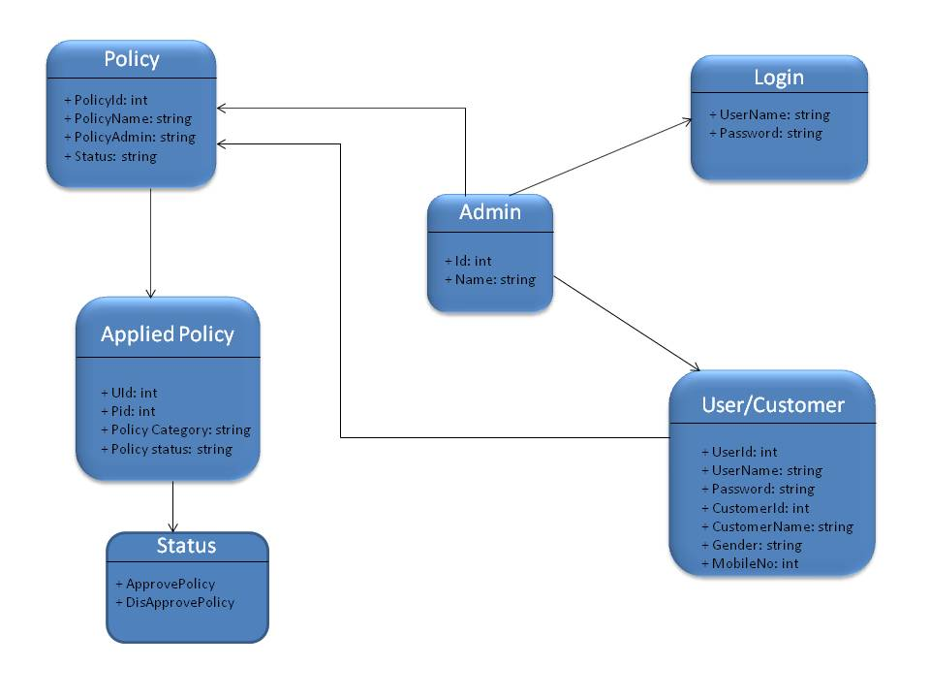
Data Flow Diagram

Slide 12
Admin E-R Diagram

Slide 13
User ER Diagram

Slide 14
Admin MODULE
Login to the portal.
Create Admin Account .
View/Update/Delete customer.
View/Add/Update/Delete policy category like Life, Health, Motor, Travel.
View/Add/Update/Delete/Approve policy.
View total policy holder, approved policy holder, disapproved policy holder.
Approve policy, applied by customer.
Answer customer question.

Slide 15
USER MODULE
Create account (no approval required by admin).
Change the password.
Change address, email, mobile.
View all policy that are added by admin.
If customer likes any policy, then they can apply for it.
When customer applies for any policy, it will go into pending status, admin can approve it.
Customer can check status of his policy under history section
Customer can ask question from admin.

Slide 16
FUTURE SCOPE
Developed to be used by the all the people.
Can be used by the students for study purpose.
It eradicates the fake policy providing websites.
Keeps the capability to centralize all the insurance industry in India and shall keep transparency in industry.
This project can bring a revolution in the insurance industry.

Slide 17
Advantages
Provides economic protection
Shares Risks
Maintain Standards of Living
Encourage Savings
Eliminate dependency

Slide 18
Disadvantages
Fraud Agencies
Not for all People
Can be Expensive

Slide 19
LET’S MOVE TO OUR PROJECT

